Slide 2
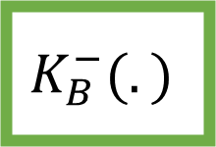
m
+
==
Validate
s
$$K_{B}^{−}(.)$$
Split
H(m+s)

Slide 3
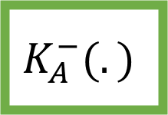
H(.)
m
+
$$K_{A}^{−}(.)$$
s
+

